Slide 1
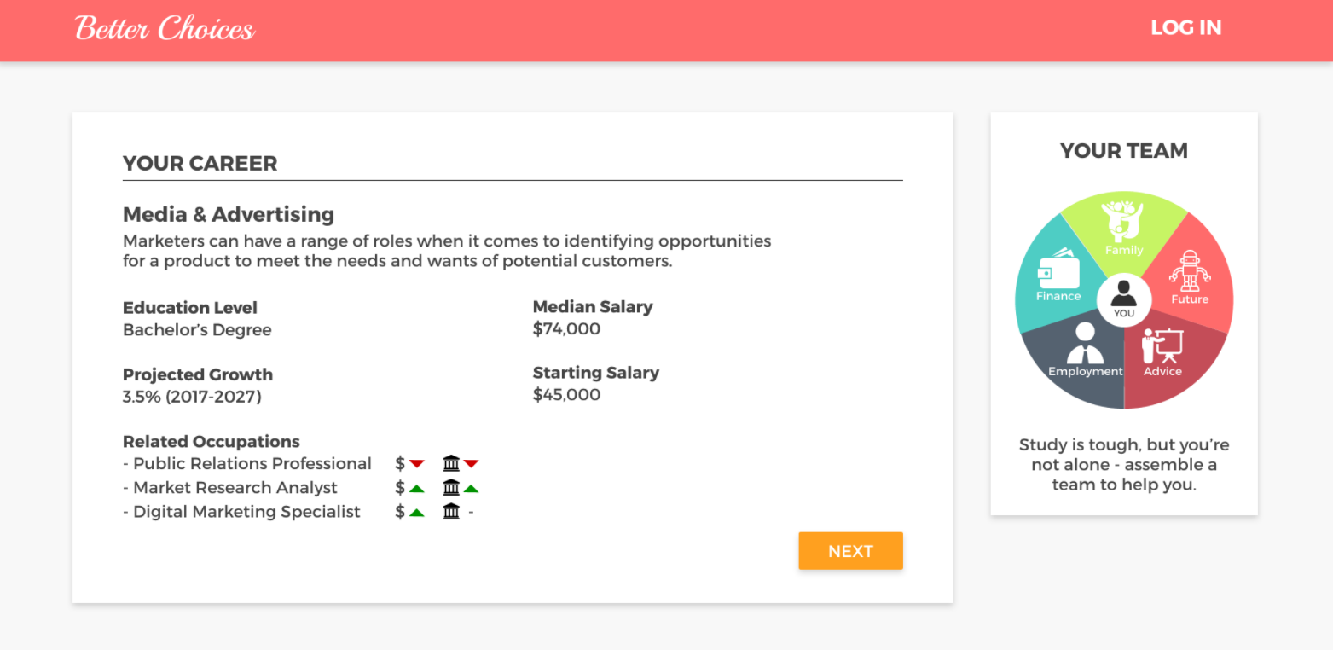
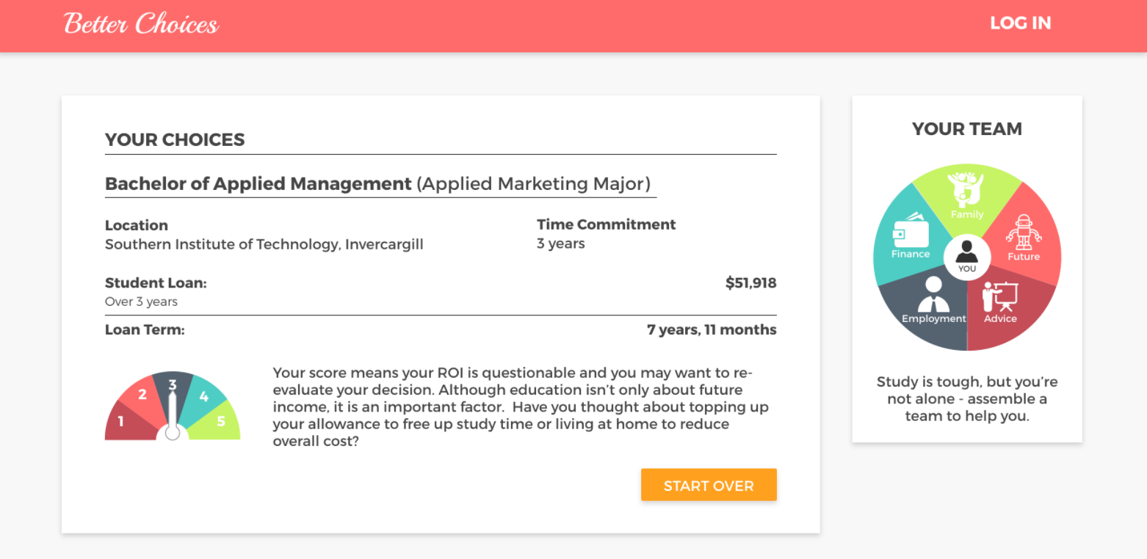
Better Choices Design Sprint - Summary
What is a Design Sprint?
A Design Sprint is a unique week-long process for answering critical questions through prototyping and testing ideas with customers.
Sprint Problem (starting point)
Customers:
Customers have difficulties understanding the factors that influence their loan balance. Their decision to draw down on their loan to fund their study choice has long-term consequences
Government:
As government, we want to improve study and borrowing choices to lift students’ prospects in their communities because there are consequences of people not finishing their studies
Sprint Outcome (desired)
Customers are more capable to make better study and borrowing choices. They show increased engagement, both at the moment they make their decision, and after the loan has been drawn down
Customers feel more empowered with increased confidence with their loan and education choices
Customers (targeted)
First-time studiers
First year borrowers
Last year secondary school students
Typical age group 16-25
Prototype
Over the course of the week the Team storyboarded a prototype intended to help customers make their study and funding choices:
Showing key information (education level, income, outlook and related occupations) of a specific career (media & advertising)
Introducing the concept of the “Team”- a support network to help customers navigate and make better study choices. The five elements in the “Team” are family, future occupational outlook, sources for career and education advice, employment and financial tools+resources.
Comparing student loan amount and loan terms based on several scenarios ( education providers, funding sources, etc.).
Using a graphic visualization tool (a half wheel “gauge”) to show the Return on Investment (ROI )of a particular scenario. ROI is based on the loan term calculated from loan amount and projected income of a specific scenario.
Customer testing
The Team tested the prototype with four customers on Friday with the following highlights:
Customers understood the tool. While they found the layout clean and simple, they would like to see definitions and additional information by hovering over text and images.
Customers appreciated the concept of the “team”, but they seek studying/career advice from different sources based on their individual circumstances. It is important to design a tool that appeals to a broad group of customers, and encourages them to build their own team based on their individual circumstances.
Customers liked the feature allowing them to evaluate different scenarios. They would like the ability to see a side-by-side comparison, and the ability to personalise the options.
One customer suggested using this tool as a personal one-stop-shop for study/finance/career decisions instead of going to multiple websites to accomplish multiple tasks.
All customers said they’d reconsider their choices after seeing how long it may take to repay their loan based on their figures.
All customers had difficulties understanding the ROI graphic. They associated the score as a test or a game, rather than a qualitative measure of the ROI calculated from loan amount and projected income.

