Slide 1
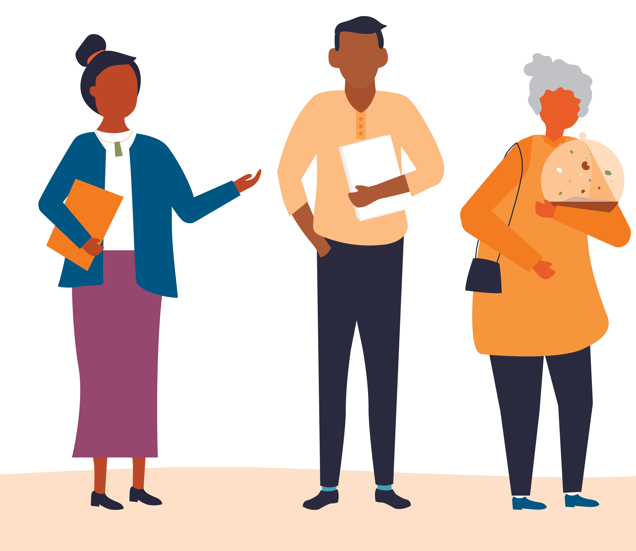


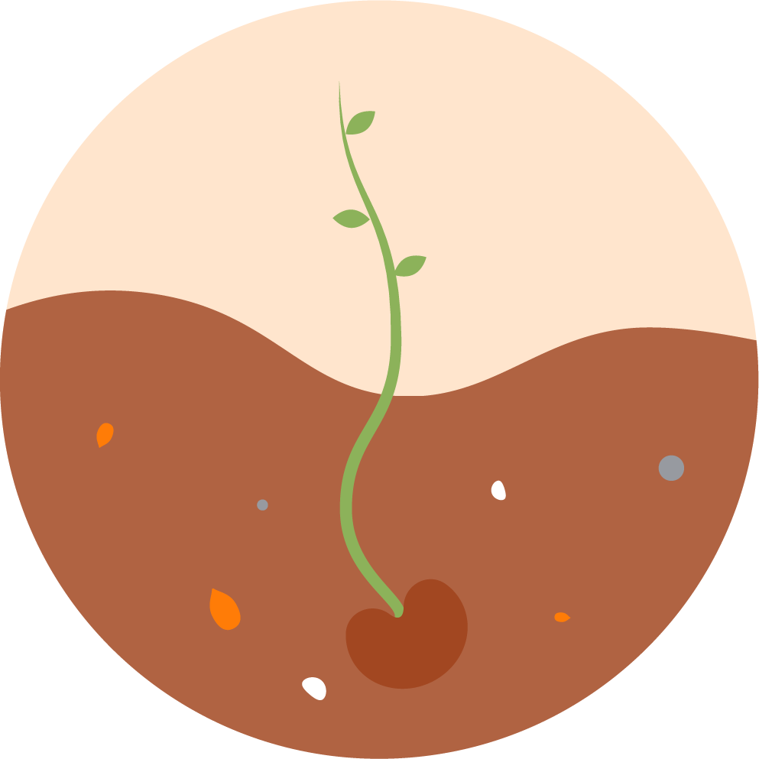

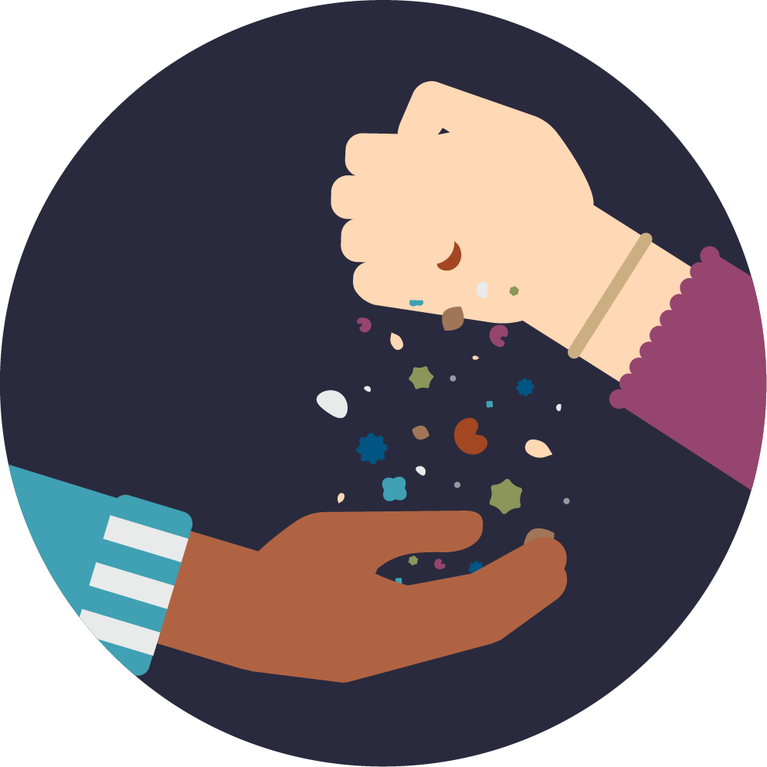


Data Protection and Use Policy (DPUP) Principles
The DPUP Principles are more about relationships than rules, because everything we do is about people, he tāngata.
Use these Principles when collecting or using people’s information:
He Tāngata
Focus on improving people’s lives — individuals, children and young people, whānau, iwi and communities.
Manaakitanga
Respect and uphold the mana and dignity of the individuals, whānau, communities or groups who share their data and information.
Mana Whakahaere
Empower people by giving them choice and enabling their access to and use of their data and information.
Kaitiakitanga
Act as a steward in a way that people understand and trust.
Mahitahitanga
Work as equals to create and share valuable knowledge.
Each Principle is set out in more detail on the following pages
digital.govt.nz/dpup/toolkit
Page 1 of 6

Slide 2
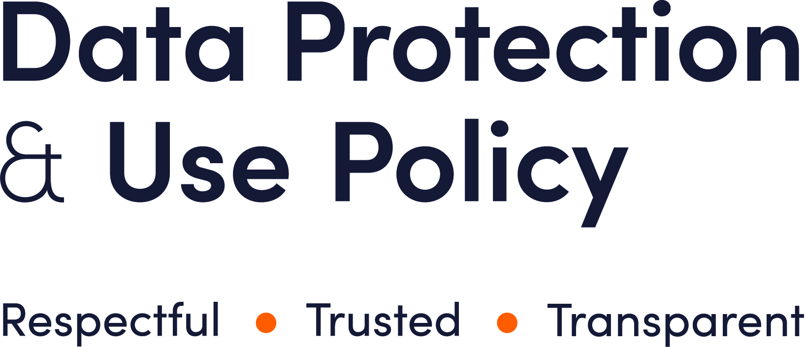

He Tāngata
Focus on improving people’s lives – individuals, children and young people, whānau,
iwi and communities.
The He Tāngata Principle has a special role. It wraps around DPUP as a whole. It reminds us that everything we do with data should be with the following question in mind: “How does this contribute toward the wellbeing of the individual or community?”.
Strive to create positive outcomes from any collection, sharing or use of data and information
Any collection, use or sharing of data and information must be for a reasonable and well-defined purpose.
There should be an easy to understand, tangible link between the purpose for which data or information is collected, used or shared, and the benefits for people. The benefit might be for certain individuals, whānau, a community or iwi, or the benefit may be a public good.
Because actions and outcomes are not always clear cut, risks and potential negative outcomes should be assessed so it’s clear how these balance against positive outcomes.
Use checks and balances and ensure that information is reasonably necessary for the purpose
Data and information exist in many different forms. Some information is more suitable or acceptable for certain purposes than others. Look at the purpose carefully before considering what information makes the most sense to use.
Some purposes need more oversight and checks than others to make sure they are well-defined and reasonable.
Only the minimum information needed to achieve the outcome should be collected, used or shared.
digital.govt.nz/dpup/toolkit
Page 2 of 6

Slide 3

Manaakitanga
Respect and uphold the mana and dignity of the individuals, whānau, communities or groups who share their data and information.
Recognise and incorporate diverse cultural interests, perspectives and needs
Be mindful of New Zealand’s cultural diversity, and the different perspectives, needs and approaches that should influence how we work.
Consider people’s and communities’ views. Learn what they think about why and how their data and information is collected, used or shared.
When deciding what information to collect and use to develop insights, recognise that different groups and people may value qualitative and quantitative information about themselves differently.
Advocate for having a diverse, informed and representative membership for data and information advisory groups, reference groups and other kinds of groups to ensure quality practice and outcomes.
Incorporate people's views when they have a specific interest in what is done with their information
For Māori this means upholding their rights as Treaty partners and focusing on the collective and whānau outcomes of any work.
For Pacific peoples this means considering the distinct views and thoughts of their diverse communities.
For children and young people, this means supporting their right to participate, communicating with them in appropriate ways and at the appropriate level, and acknowledging what they have to say is valuable.
For disabled people this means considering accessibility issues, focusing on what works well for them, understanding their achievements and contributions, and making sure they are not ‘invisible’ in data and information.
Other people and groups are likely to have their own specific needs and priorities. It is important to be proactive in identifying and addressing those needs and priorities.
Employing people with the relevant cultural competence and experiences will help service delivery agencies engage effectively with these communities and groups.
Include and involve service users whenever possible
People can offer greater value than just their information and data.
Their ideas and views are valuable. Include these when developing or testing proposals to collect and use data or information to improve wellbeing.
digital.govt.nz/dpup/toolkit
Page 3 of 6

Slide 4

Mana Whakahaere
Empower people by giving them choice and enabling their access to and use of
their data and information.
Where possible, give people choices and respect the choices they make
Tell people, in a way that makes sense to them, what data or information is collected about them, how it’s used, who it’s shared with, and why, even if it’s used or shared in a way that does not and cannot be used to identify them. There will be situations where there are good reasons not to tell them, for example, if it would undermine the purpose of the collection, or it’s just not possible to tell the person.
Consider people’s wellbeing and provide choices about what is collected, how it’s used and why, and whether it’s shared — unless it’s not safe or appropriate to do so.
Take extra care when deciding not to give people choices or not to explain to them how their information will be used and why.
It's not appropriate to rely on broad or ‘future-proofing’ purpose statements or consents for potential uses that are loosely defined.
Even when there is no legal requirement to tell people, transparency is important for trust and respect, and recognising people’s mana.
If it’s not timely or appropriate to tell them beforehand, tell them afterwards — unless there’s good reason not to.
When communicating with children and young people, consider their vulnerability and the roles that their parents, guardians or wider whānau may play in supporting them.
Give people easy access to and oversight of their information wherever possible
People should not have to rely on Privacy Act requests to access information held about them.
Encourage people to see what is recorded about them. This is a way to empower them and acknowledge that their data and information is part of their story and experiences.
Making it easy for people to see their data and information can mean many things. This may include showing them what is written on a computer screen, including them on email referrals to another agency (taking care to double-check email addresses), or providing information in accessible formats for people with a sight disability or limited literacy.
Whenever possible, help people check, add or correct their information.
Help people access their information so that they can share it with others and avoid retelling their story.
digital.govt.nz/dpup/toolkit
Page 4 of 6

Slide 5
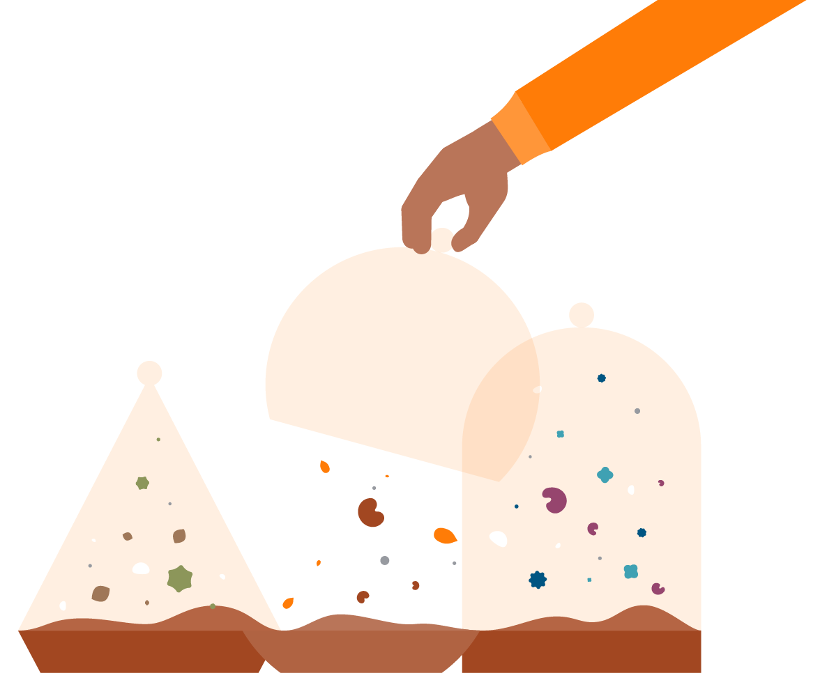
Kaitiakitanga
Act as a steward in a way that people understand and trust.
Be a kaitiaki rather than an owner of people's information
Those who collect, use, share and store data and information are kaitiaki, stewards and caretakers, not owners, of that data and information.
Being a kaitiaki is about working in the service of, and being accountable to, New Zealanders around the collection, use and sharing of their data and information, and ensuring that it is valued and respected.
A kaitiaki recognises the importance of people being able to access their information and helps them do that.
Be open and transparent — support people’s interest or need to understand
Have open conversations about the collection, use and sharing of data and information and the reasons for them. This means building trust, being inclusive, respecting a wide range of views, and working in partnership.
Explain things in an accessible and easy to understand way, and in a manner that matches people’s needs and interests. Use different types or formats of data and information, as well as levels of detail, to match different interests, levels of comprehension, context and needs of different groups.
Keep data and information safe and secure and respect its value
Use data management practices that are safe and secure. Keep in mind the nature of the information and data, as well as how it is being collected, used, shared, analysed and reported.
Those who collect data and information need easy-to-use tools and processes for accurately and efficiently collecting, using and sharing information.
Treat data as a valuable asset. Store and maintain it so that it is accessible and reliable, and only keep it for as long as it is necessary and relevant.
Those who hold people’s information are able to grow its value. They may do this by creating and sharing insights, or by returning collective, non-personal data back to the people and community it came from for their use. In all cases they must comply with the law, protect people’s privacy and maintain people’s trust and confidence.
If there’s a privacy breach, act quickly and openly
If a privacy breach occurs, recognise its potential significance to people, address it quickly, and be accountable for it.
If serious harm has occurred or is likely to occur, notify the Privacy Commissioner and affected service users in accordance with the Privacy Act.
Even if serious harm has not occurred and is not likely to occur, consider whether to notify affected service users.
Take steps to make amends, to avoid similar breaches in the future, and to maintain or restore trust and confidence in the service.
digital.govt.nz/dpup/toolkit
Page 5 of 6

Slide 6

Mahitahitanga
Work as equals to create and share valuable knowledge.
Work with other agencies to create and share value together
Consider other agencies’ resource needs and costs if your agency relies on them to collect, store or use data, including applying good information practices.
Include a wide range of people in projects or activities that collect or use people's information so capacity and knowledge grows. Other agencies may have an interest in using that information to improve wellbeing, and may contribute to exploring new ideas.
Work with others who collect data and information to minimise duplication, as well as the burden on people who gather or share information.
Work with iwi and other Māori groups as Treaty partners regarding personal data and information. Involve them in decisions over data and information issues that affect them.
Grow collective knowledge and improve services through 2-way sharing of non-personal information
People's non-personal information such as de-identified data, analysis, results and research findings can often be useful to others working with relevant communities.
Enable organisations or groups with a clear and legitimate interest to safely and easily access and use government-held data sets in a de-identified form for locally led development.
Share expertise and help others understand and use data accurately and safely, for example, ensuring that people are not re-identified.
Advocate for, and support ‘by / for’ research (like Kaupapa Māori) so communities or groups better understand their own goals and priorities and the needs of their people.
Create feedback loops with people and organisations who contribute data and information. Tell them the outcomes of any use of their data and the value it created.
Carefully share information so people get the support they want and need
Enable other professionals to support people by making sure they have the information they need to do their work, within what the law permits.
Recognise the diverse and complex nature of the services government offers and use it as an opportunity to connect with others to improve outcomes for individuals. In many situations, no single professional or agency will have the whole picture.
digital.govt.nz/dpup/toolkit
Page 6 of 6

