Slide 1
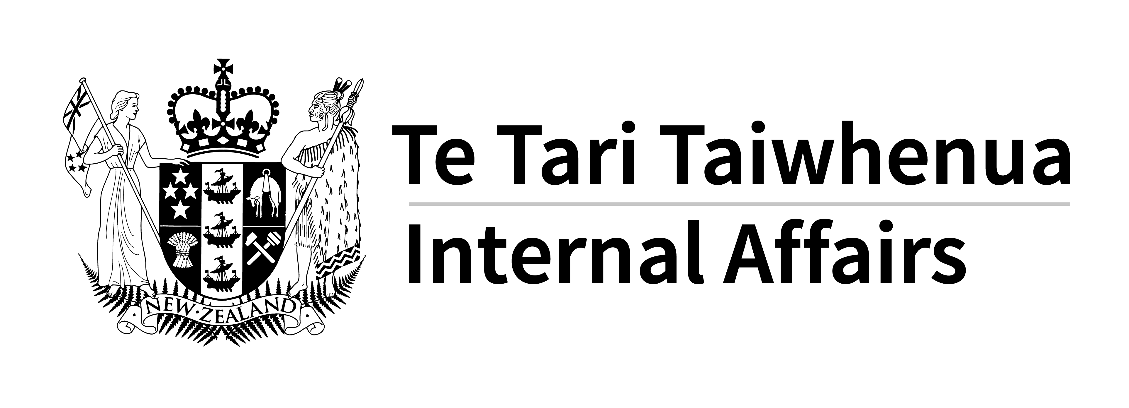
The Data Protection and Use Policy (DPUP)
DPUP summary for data analysis, research or evaluation
Information from or about service users is often used for analysis, research, evaluation and other similar activities.
Qualitative or quantitative analysis, modelling and forecasting the cost of services, research or evaluation of interventions are all examples of where people’s data or information may be used. If you’re involved in this kind of work, you might decide what to collect from or about people, or you might use information that’s already gathered.
As a kaitiaki, create a culture where data or information is used in respectful, transparent and trustworthy ways.
Uphold people’s mana and recognise the person and story behind the numbers. Support the Manaakitanga and Mana Whakahaere Principles.
Keep in mind
often think of information they have supplied or that is about them as personal, even when it has been de-identified or anonymised and is being used in a non-personal form. Whenever your work is about people, the key parts of good practice are being clear about purpose, supporting transparency and choice, enabling people to access their information, and sharing the value of the insights developed using people’s information.
!
The DPUP Principles are values and behaviours that underpin respectful, transparent and trusted use of data and information:
Be clear about the purpose
Write down the purpose for collecting or using people’s data or information in an easy to understand way. It’s vital to be clear about purpose so that you can be transparent, and check ethical and legal requirements. Remember: if identifying information isn’t needed, then it should not be collected or used. Never ask for any data or information to be collected or shared without explaining why it’s needed or how it will be used.
‘Just in case’ is not an okay reason to collect data or information. ‘We have it so let’s use it’ is not okay either. With the increased availability of administrative data and easier access to technology to analyse it the risk of overcollection and misuse has also increased. For this reason, it has become important to stop, think and check why something is collected, why it’s passed on and if it’s okay to use it.
He Tāngata Improve outcomes for service users, whānau and communities..
Manaakitanga Uphold the mana and dignity of those who share their data and information.
Mana Whakahaere Empower people – include them and enable their choices.
Kaitiakitanga Act as a steward in a way that’s transparent, understood and trusted.
Mahitahitanga Work as equals to create and share valuable knowledge.
See the full versions of the Principles at: digital.govt.nz.dpup/principles
Keep focused on the He Tāngata Principle. Make sure it’s clear how any collection or use of data or information will benefit service users, people in similar situations, or the wider community.
If you decide what to collect and why, then get a wide range of views, including from service users, about what is fair and reasonable to do for this purpose.
Work as equal partners and involve service users
The Mahitahitanga Principle is about working with others in a way that reflects a joint responsibility to be respectful, transparent and trustworthy. Involve others when designing research, analysis or evaluation, deciding what to collect or use, how to analyse information and forming conclusions and insights.
Collaborate in ways that make sense for the context and work. If there’s no intention to use identifiable or sensitive data, no negative consequences for people, and they’re aware this work is happening, then this will need less engagement than uses of sensitive information or work that has big implications for people.
Involve people who understand the circumstances of those the information is about: frontline workers who collect it directly, and those who work with people, whānau and communities. Include service users themselves wherever possible.
Any use of information that identifies service users needs careful thinking and thorough checking. The purpose must be clear, understood by all involved and communicated to service users.
If the data or information was not collected for this purpose, then is it legal, ethical, fair and reasonable to use it?
If people’s information will be used for a purpose they do not know about or may not agree with, whether it identifies them or not, does the purpose justify it? How would it affect people’s trust if they found out?
digital.govt.nz/dpup/toolkit
Page 1 of 2

Slide 2
The Data Protection and Use Policy (DPUP)
DPUP summary for data analysis, research or evaluation
Even if you don’t meet service users, you still need to provide an explanation about the use of their data or information in a way they understand, so that anyone who collects it can explain it to them.
If you’re using it, you’re responsible for explaining it.
Check
How will people’s mana and dignity be upheld if their data or information will be used for research, analysis or evaluation?
We need it to...
They need it to...
How do those whose data or information it is about feel about this purpose? Ask them or talk to groups of service users.
Okay, we’ll tell them...
Okay, I understand.
Were people told that their information would be used for this? Did they have a choice? What does this mean for how fair, reasonable and respectful it is to use their information this way?
Be transparent and support choices
People should have as many choices as possible about what data or information they provide, who gets to see or use it and why. Just because it does not identify them, does not mean they will not want a say.
There may be times when it’s not safe or appropriate to offer choices. If this is the case, it should be made clear why this is fair, reasonable and respectful.
Consult with others and think carefully about transparency and choice. Not being transparent or not giving choices can have negative effects on people’s trust and engagement. Be proactive about access and correction. engagement.
Have a wide range of people, including service users, been involved in undertaking the work?
Would another method or technique achieve the purpose well enough and allow more choice?
Be proactive about access and correction
People have a legal right to access their personal information (that does or can identify them) and ask for corrections to be made (except in specific situations covered by the Privacy Act).
If personal information is used for analysis, research or evaluation, think about how access and correction will work. Recognise the person behind the data — access is part of upholding their mana and dignity.
What collection and storage options will make access as easy as possible?
Is it clear to service users what kind of information is accessible and how changes can be made?
The Mahitahitanga Principle is about working together though all phases of analysis, research and evaluation. This means sharing the knowledge created using data and information from or about service users, whānau and communities. See the Sharing Value Guideline at digital.govt.nz/dpup/guidelines for more information.
Think carefully about what to share and who to share it with. For those with a legitimate need, provide safe access to what’s appropriate. This might mean de-identified data tables and details of people’s experiences (that do not and cannot identify people), summaries of data or information or final results.
Sharing insights opens doors to understanding and is a powerful tool for better support for New Zealanders. It’s through sharing value that collective knowledge grows.
If data or information is shared or linked across agencies, how will people know where it’s gone, how to access it or ask for corrections to it?
Share value
Is there a plan to share value with the service users and communities who the work is about?
Have ways to support Kaupapa Māori, ‘by Pacific peoples for Pacific peoples’ research, or ownership of analysis by those it affects been explored?
Research and statistical purposes
The Privacy Act 2020 says people don’t need to be told when their data or information will be used for ‘research and statistical purposes’ that will not or cannot identify them. DPUP recommends that it’s good practice to be transparent about any purpose or use, even when people can’t be identified. In terms of transparency, writing ‘for research and statistical purpose’ is not very clear. It does not accurately describe what’s being done, how it’s been done or why and will not mean much to service users or other stakeholders.
Go to digital.govt.nz/dpup for more resources and tools, including more about being clear about Purpose, Transparency and Choice, Access to Information, Sharing Value and Mahitahitanga.
digital.govt.nz/dpup/toolkit
Page 2 of 2

